Slide 1


2020
Netcoreconf
Azure Kubernetes Service: Lessons Learned
Carlos Mendible
Azure Evangelist @everis
Azure & Developer Technologies MVP
29/02/2020
@cmendibl3

Slide 2
2020
Netcoreconf
Azure Kubernetes Service: Lessons Learned
Carlos Mendible
Azure Evangelist @everis
Azure & Developer Technologies MVP
29/02/2020
@cmendibl3

Slide 3
Sponsors

Slide 4
GOALS: Answer the following questions
What happened to the dashboard?
How should we deploy our apps?
How can we protect AKS with a firewall?
How easy is to setup an ingress?
How can we upgrade a cluster?
How do I patch the cluster?
Can I get rid of the worker nodes?
What about stateful applications?
Can multiple Teams work in the same cluster?
How should we handle secrets?
Notes:
QUE QUIERO QUE CONSIGAMOS HOY?

Slide 5

Repeat after me…
GIT
On-premises
Kubernetes
Notes:
QUE QUIERO QUE CONSIGAMOS HOY?

Slide 6
What happened to the dashboard?
If your AKS cluster uses RBAC, a ClusterRoleBinding must be created before you can correctly access the dashboard.
By default, the Kubernetes dashboard is not deployed.
az aks enable-addons --addons kube-dashboard -g <rg> -n <name>
kubectl create clusterrolebinding kubernetes-dashboard --clusterrole=cluster-admin --serviceaccount=kube-system:kubernetes-dashboard
Notes:
QUE QUIERO QUE CONSIGAMOS HOY?

Slide 7

How should we deploy our apps?
Use Helm
Stay away from Tiller → Use Helm 3 or else Bake!!!
For the inner loop use Draft, Skaffold, Azure Dev Spaces, etc…

Slide 8

Notes:
? DEMO

Slide 9
How can we add an ingress to AKS?
AKS HTTP application routing feature: Azure platform creates the Ingress controller and an External-DNS → Disable
Use NGINX + Let's Encrypt
SSL/TLS termination
Azure Application Gateway Ingress Controller
WAF (Web application firewall)
Pod Managed Identity

Slide 10
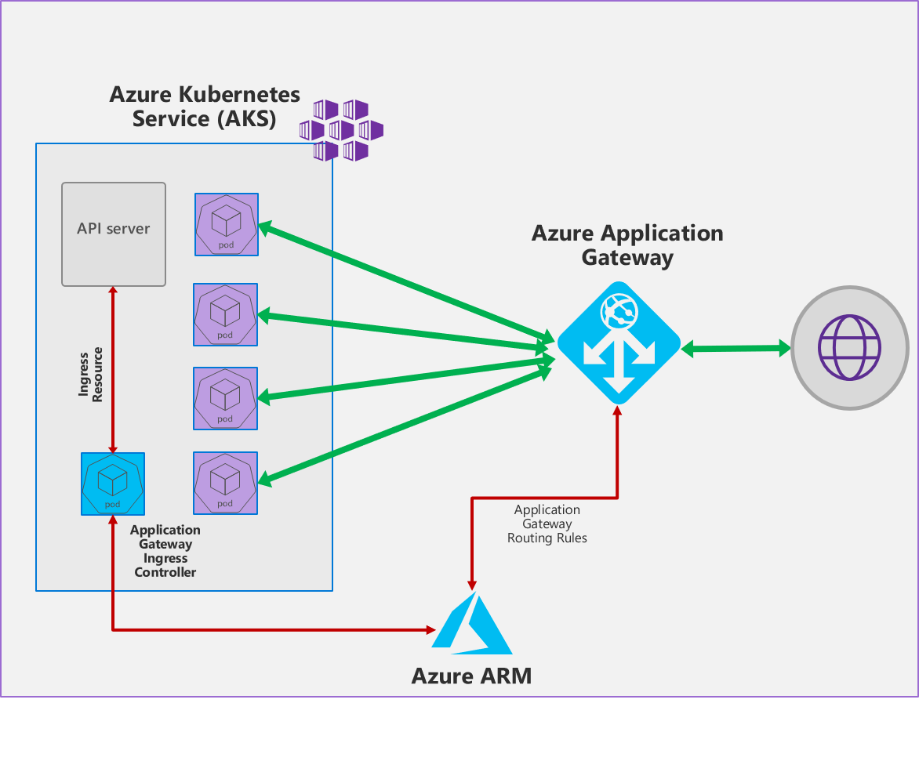
How can we protect AKS with a firewall?

Slide 11
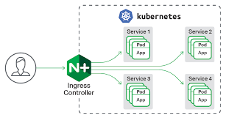
How easy is to setup an ingress?

Slide 12

Notes:
INGRES DEMO → AAD?

Slide 13
How can we upgrade a cluster?
All at once
az aks upgrade --name $clustername --resource-group $rg --Kubernetes-version 1.14.8
Use Node Pools
Upgrade the Control Plane to latest version
az aks upgrade -n $clustername -g $rg -k 1.14.8 --control-plane-only
Add a new NodePool with latest version
Deploy containers on the new NodePool and test
Remove the old NodePool
Use a New Cluster

Slide 14
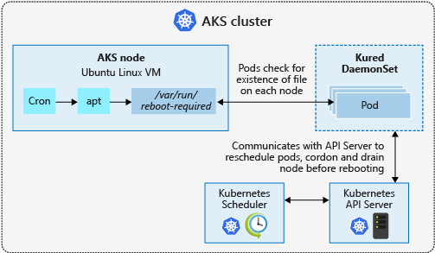
How do I patch the cluster?
Use Kured
A new node is deployed with the latest security updates and Kubernetes version applied.
An old node is cordoned and drained.
Pods are scheduled on the new node.
The old node is deleted.
Notes:
kubectl apply -f https://github.com/weaveworks/kured/releases/download/1.2.0/kured-1.2.0-dockerhub.yaml
https://docs.microsoft.com/en-us/azure/aks/ssh
https://dev.to/cdennig/keep-your-aks-worker-nodes-up-to-date-with-kured-1pan

Slide 15

Notes:
UPGRADE DEMO

Slide 16
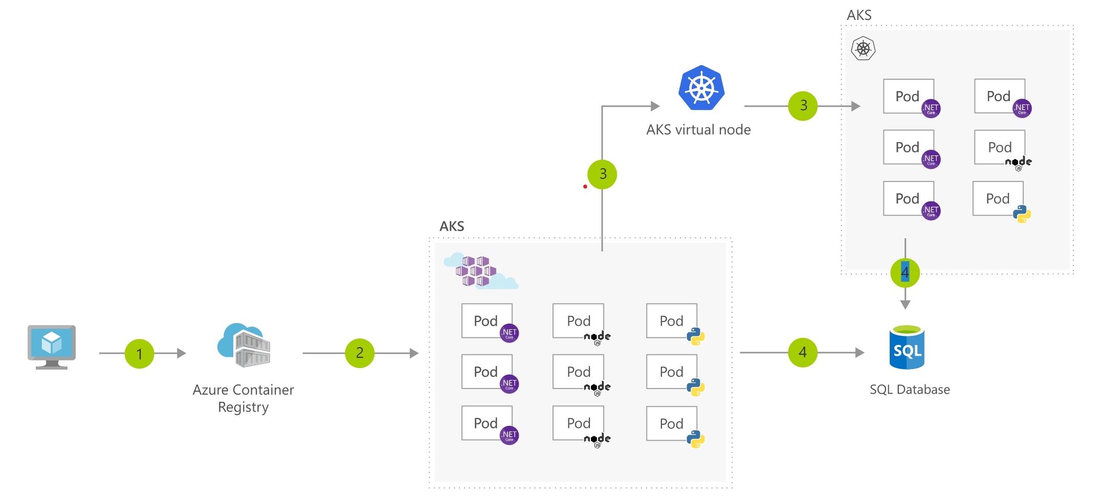
Can I get rid of the worker nodes?

Slide 17

Notes:
VIRTULA-KUBELET DEMO

Slide 18
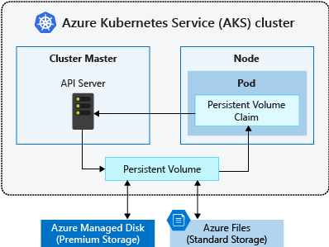
What about stateful applications?
Azure Disks:
Use Premium storage.
Mounted as ReadWriteOnce, so are only available to a single node
Azure Files:
Only use Azure Standard storage backed by regular HDDs
Used to mount a SMB 3.0 share backed by an Azure Storage account to pods. Files let you share data across multiple nodes and pods.
Notes:
https://docs.microsoft.com/en-us/azure/aks/operator-best-practices-storage
Los discos nos van a dar mas performance, pero necesitaríamos q el pod pudiese recrear info si cambia de nodo

Slide 19

Notes:
K8S STORAGE DEMO → Storage Account Storage Class →

Slide 20
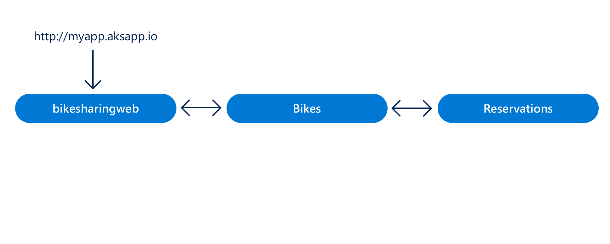
Can multiple Teams work in the same cluster?
A rapid, iterative Kubernetes development experience for teams
Work directly in AKS
Iterate and debug using Visual Studio or Visual Studio Code.
Generate Docker and Kubernetes configuration-as-code assets.
Share a cluster with your team and collaboratively work together.
Develop your code in isolation, and do end-to-end testing with other components without replicating or mocking up dependencies.
Notes:
CARLOS ESTA PARA TÍ!
A rapid, iterative Kubernetes development experience for teams
Minimize local dev machine setup for each team member and work directly in AKS, a managed Kubernetes cluster in Azure.
Rapidly iterate and debug code directly in Kubernetes using Visual Studio 2017 or Visual Studio Code.
Generate Docker and Kubernetes configuration-as-code assets for you to use from development through to production.
Share a managed Kubernetes cluster with your team and collaboratively work together.
Develop your code in isolation, and do end-to-end testing with other components without replicating or mocking up dependencies.

Slide 21
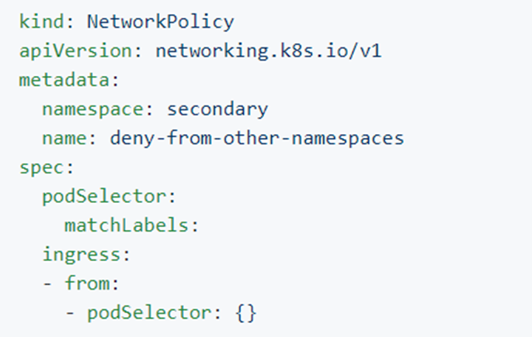
AKS: Network Policies (Preview)
All pods in an AKS cluster can send and receive traffic without limitations, by default
Secure traffic between pods using network policies
Choose to allow or deny traffic based on settings like assigned labels, namespace, or traffic port
Notes:
Calico: https://github.com/projectcalico/calico
https://github.com/ahmetb/kubernetes-network-policy-recipes/blob/master/04-deny-traffic-from-other-namespaces.md

Slide 22

Notes:
AZDS DEMO

Slide 23
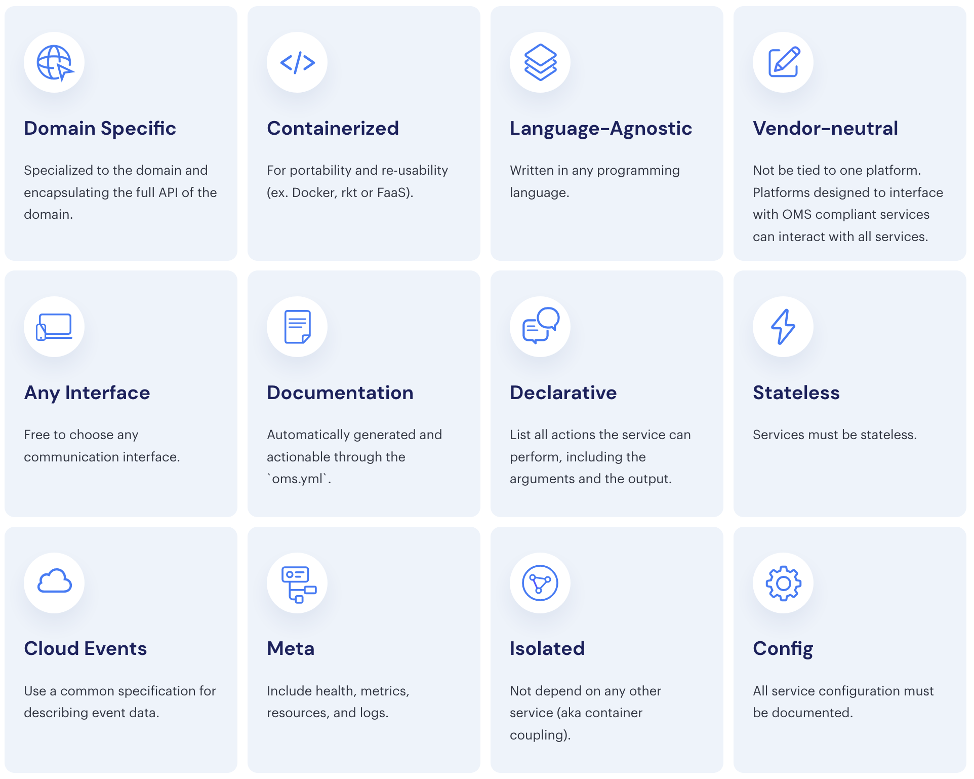
The Twelve-Factor Microservice
Notes:
AHORA VAMOS A VER LO QUE SUCEDE EN EL MUNDILLO DE LOS PALABROS COMO MICROSERVICIOS Y CONTENEDORES.
LAS SOLUCIONES BASADAS DIRECTAMENTE EN EL KEYVAULT SECRET MANAGER ACOPLAN DIRECTAMENTE NUESTAR APLICACION CON ESA SOLUCION Y CON AZURE
LO QUE IMPLICA QUE NO CUMPLIMOS CON UNOS DE LOS FACTORES DE APOSTAR POR LA NEUTRALIDAD RESPECTO AL VENDOR.
Y CREEDME MUCHOS DE MIS CLIENTES SE PREOCUPAN POR ESTO.
https://openmicroservices.org/

Slide 24
Kubernetes, Micros & Key Vault Integration
Syncing Kubernetes Secrets: who & how?
Microservices have Key Vault dependencies
Environment variables are a “De Facto Standard”
Need a KISS solution
Notes:
Y AHORA METEMOS EN LA FOTO A KUBERNETES, QUE TIENE SU PROPIA SOLUCION PARA GESTIONAR SECRETOS Y QUE TAMPOCO GUSTA A MIS CLIENTES
QUEREMOS EVIATR DEPENDENCIAS DIRECTAS CON EL KEY VAULT
SABEMOS QUE TODO LENGUAJE QUE SE RESPETA HOY EN DIA PUEDE LEER CONFIGURACION DE VARIABLES DE ENTRNO DE FORMA TRANSPARENTE
Y NECESITAMOS UNA SOLUCION EN LA QUE MANTENGAMOS NUESTROS DESPLIGUES Y APLPCIACIONES LO MAS SIMPLE POSIBLE.

Slide 25
How should we handle secrets?
Use Azure Key Vault for secrets when needed:
Kubernetes-KeyVault-FlexVolume.
Pod Managed Identity (Preview)
Admission Controllers
Dapr

Slide 26
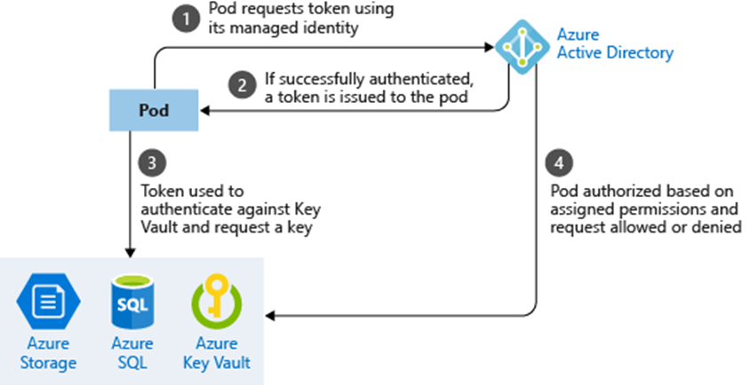
Using pod managed identities
Notes:
The pod is assigned an Azure Identity that lets them authenticate to Azure Active Directory and receive a digital token.
The digital token can be presented to other Azure services that check if the pod is authorized to access the service and perform the required actions.

Slide 27

Notes:
DAPR + KEY VAULT SECRETS DEMO

Slide 28

dapr
An event-driven, portable runtime for building microservices on cloud and edge.
Powerful Building Blocks
Open API
Works with any programming language
Open Source
Notes:
Y AHORA METEMOS EN LA FOTO A KUBERNETES, QUE TIENE SU PROPIA SOLUCION PARA GESTIONAR SECRETOS Y QUE TAMPOCO GUSTA A MIS CLIENTES
QUEREMOS EVIATR DEPENDENCIAS DIRECTAS CON EL KEY VAULT
SABEMOS QUE TODO LENGUAJE QUE SE RESPETA HOY EN DIA PUEDE LEER CONFIGURACION DE VARIABLES DE ENTRNO DE FORMA TRANSPARENTE
Y NECESITAMOS UNA SOLUCION EN LA QUE MANTENGAMOS NUESTROS DESPLIGUES Y APLPCIACIONES LO MAS SIMPLE POSIBLE.

Slide 29
Sponsors

Slide 30

Más información:
info@netcoreconf.com
@Netcoreconf
Visítanos en:
netcoreconf.com
GRACIAS

Slide 31
AKS: Limits & Resource Reservations
Max clusters per subscription: 100
Max nodes per cluster: 100
Max pods per node: Basic Networking: 110
Max pods per node: Advanced Networking : 110
CPU 60 ms
Memory 20% up to 4 GiB
Notes:
Aquí están los límites: https://docs.microsoft.com/fi-fi/azure/aks/container-service-quotas
Ojo q en advanced x defecto es 30, pero puedes cambiarlo al momento de la creación (no desde le portal)
La reserva de recursos es para el funcionamiento de kubernetes. Hablamos de los nodos
Si tienes 8 GB reservara 1,6GB
Si tienes 32 seria 6,4, así que lo deja en 4

Slide 32
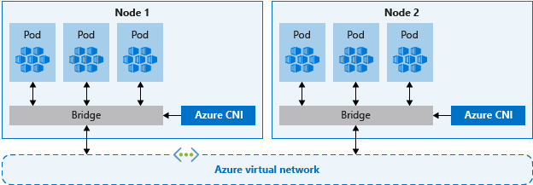
AKS: Networking
Basic networking
The Azure platform manages the network configuration of the cluster and pods.
With basic networking, you can't define network configuration such as subnet names or the IP address ranges assigned to the AKS cluster.
Nodes in an AKS cluster configured for basic networking use the kubenet Kubernetes plugin.
Expose a Kubernetes service externally or internally through the Azure Load Balancer.
Pods can access resources on the public Internet.
Advanced networking
Advanced networking places your pods in an Azure virtual network that you configure.
Better performance than basic networking
Notes:
https://docs.microsoft.com/en-us/azure/aks/operator-best-practices-network
Nodes in an AKS cluster configured for advanced networking use the Azure Container Networking Interface (CNI) Kubernetes plugin.
Hablaremos más adelante pero si eliges “Advanced networking“puedes tb añadir el plugin calico, que nos permitirá establecer políticas

Slide 33
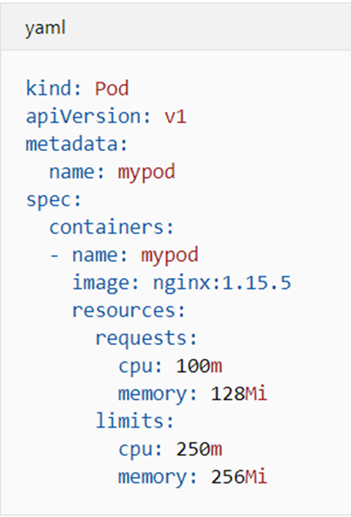
AKS: Pod requests and limits
Pod requests
amount of CPU and memory that the pod needs.
Pod limits
Maximum amount of CPU and memory that a pod can use.
Notes:
Pod requests define a set amount of CPU and memory that the pod needs. These requests should be the amount of compute resources the pod needs to provide an acceptable level of performance.
Pod limits are the maximum amount of CPU and memory that a pod can use. These limits help prevent one or two runaway pods from taking too much CPU and memory from the node. This scenario would reduce the performance of the node and other pods that run on it.

Slide 34
Azure Managed Identity
Azure Instance Metadata Service (IMDS)
REST endpoint
The endpoint is available at a well-known non-routable IP address (169.254.169.254) that can be accessed only from within Azure ARM Services
Notes:
AZURE INSTANCE METADATA SERVICE ES UN ENDPOINT REST
Y ES UN IP 169.254.169.254 QUE SOLO PUEDE SER ACCEDIDO DESDE SERVCIOS DE AZURE ARM.

Slide 35
Azure services that support Azure AD authentication
Azure Resource Manager
Azure Key Vault
Azure Data Lake
Azure SQL
Azure Event Hubs
Azure Service Bus
Azure Storage blobs and queues
Azure Analysis Services
Notes:
Y ESTA LA LISTA DE SERVICIOS QUE SOPORTAN AUTENTCACION VIA AZURE AD
https://docs.microsoft.com/en-us/azure/active-directory/managed-identities-azure-resources/services-support-managed-identities

